Slide 1
Azure Kubernetes Service HACKATHON

Slide 2





HACK PROCTORS
Saurabh Vartak – CSA
Vijay Jethani – CSA
Sumit Kute – CSA-P
Vidhyadhar Pandit - CSA
Shiva Tomar - CSA

Slide 3

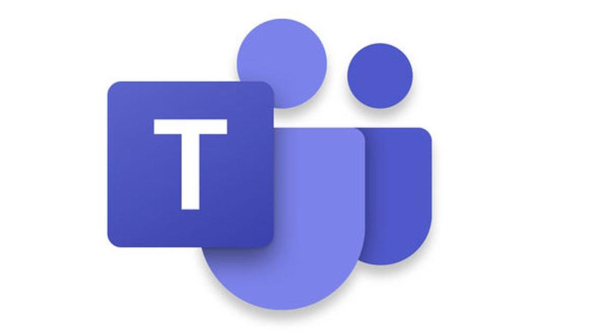
Hackathon Kickoff
WORK AS A TEAM
Source: https://www.outlife.in/uploads/6/1/9/7/6197204/839049869.png

Slide 4
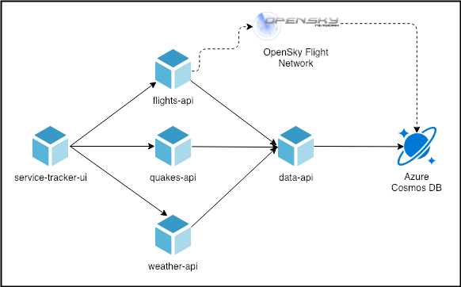
Use Case for the Hack

Slide 5

Hackathon Kickoff
6 Objectives
Bonus
Day 1
Run Locally
Deploy to Azure Kubernetes Services
App Gateway
Use Helm Deploy
Day 2
CI/CD Automation
using Azure DevOps
Network & Security
Monitoring & Logging
Setup HPA

Slide 6
Pre-requisites
Microsoft Azure Subscription
VS Code
Azure DevOps Subscription
Azure CLI
Docker Desktop

Slide 7
Hackathon Guidelines
Each team will be assigned a proctor.
Once you complete an objective please review it with the proctor. On approval by the proctor you can move to the next objective.
You must complete a minimum of 3 objectives in a day.
You are free to use tools which you are comfortable working with.

Slide 8

Objective 1: Run Locally
The source code is available at the GitHub location here
Run the solution locally using docker-compose
Use of MongoDB container for local DB deployment
Source https://cdn.onlinewebfonts.com/svg/img_175952.png

Slide 9
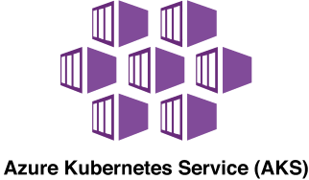
Objective 2: Deploy to Azure Kubernetes Services
Create Azure Kubernetes Cluster
Use Advanced Networking and choose Network Policy as Azure
Create a separate namespace “hackTEAMNAME”
Create Application Insights Instance
Create Cosmos DB
Ensure that the credentials of CosmosDB & the Application
Insights Instrumentation Key are stored as AKS Secrets
Configure ACR integration with AKS
Create docker image using ACR Tasks
Try to use ACR for building the images – reference
Create Deployment & Services manifest files for all services
Expose the service-tracker ui on Public IP, rest on Private IP’s
Mostly use YAML

Slide 10


App Gateway + Helm Deploy (Bonus)
Deploy behind App Gateway
+
Install helm 3.x
Create helm chart for these services
Deploy helm chart with CLI
Try to use YAML as far as possible
https://docs.microsoft.com/en-us/azure/container-registry/container-registry-quickstart-task-cli

Slide 11
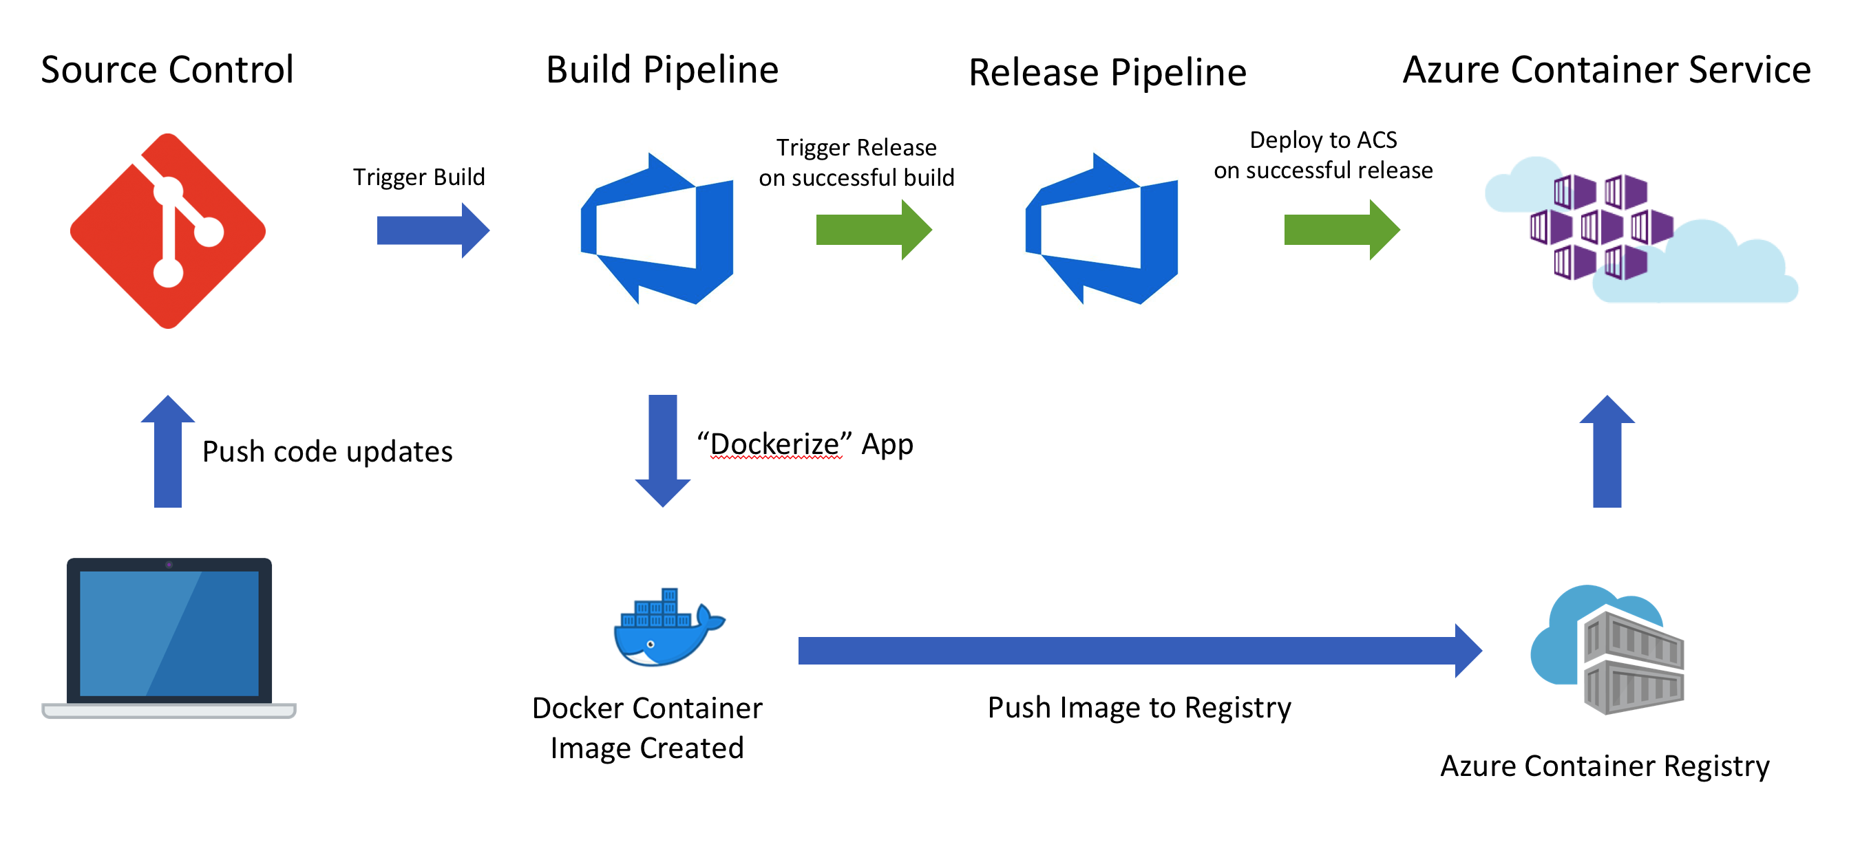
CI/CD Deployment
Check-in all your code into Azure Repo
Ensure you build & deploy your containers using Azure DevOps

Slide 12
Network & Security
Create Private Ingress Controller behind App Gateway
Network Policy to allow only flight, quakes & weather API to call data API

Slide 13
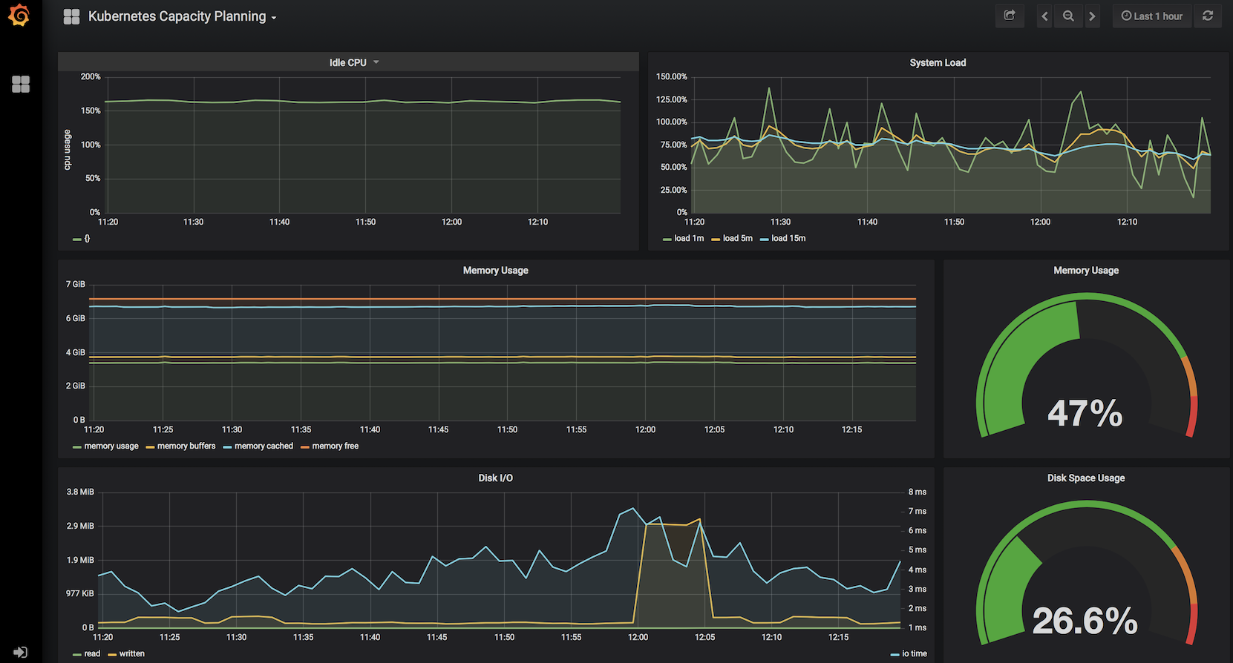
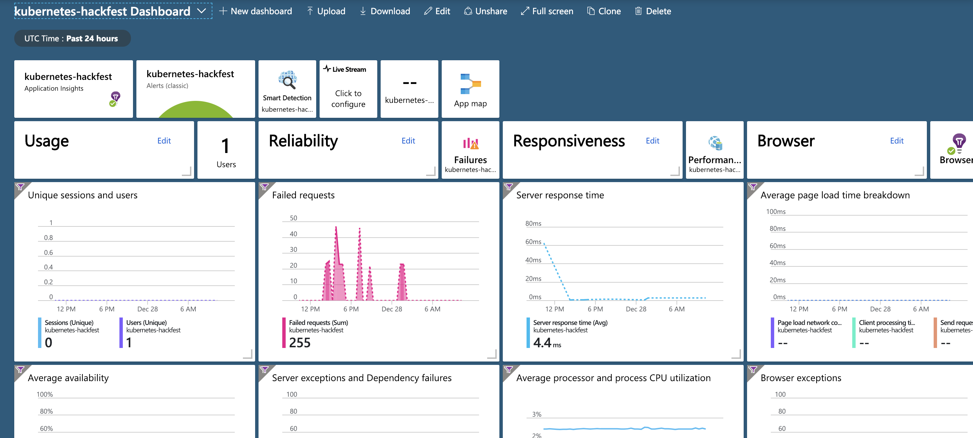
Enable Monitoring & Logging
Enable Azure Monitoring
Configure Prometheus Monitoring and expose it via Public IP

